Slide 1


Slide 2
Our Mission
We are a compassionate Christian ministry dedicated to enriching the quality of life for seniors of all faiths

Slide 3
PCSC Values
Service
Excellence
Relationships
Teamwork
Stewardship

Slide 4

All five of PCSC’s short-term rehab units received U.S. News and World Report’s “Best Nursing Home” Award … the top rating.
  Only 13% of the units reviewed nationally received the “Best” rating.

Slide 5
What needs to happen to improve and possibly expand each campus
    To serve better
    To serve more
What is feasible and what isn’t?
Master Planning

Slide 6
Foothills was first, and expansion/renovation is being planned
Clinton and Columbia have been completed – next steps are being contemplated
Master Planning

Slide 7
That was then – This is now
1958
1 community
(Summerville)
20 residents
2025
6 communities
1,000 employees
950 residents

Slide 8
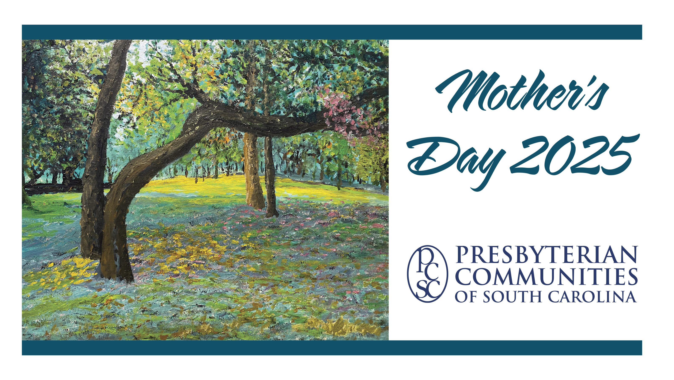

Slide 13
Other interesting statistics
Age range of residents receiving charitable care
89 - 100+
Average years at PCSC before receiving charitable care
7 years
Average years receiving charitable care
2 years

Slide 14
2024
Gifts from Congregations of
Charleston-Atlantic Presbytery
Mother’s Day Offering $25,964
Charitable Care – Current $11,300
Total congregational gifts $37,264
  35 gifts
  18 congregations

Slide 15
Charleston-Atlantic Presbytery Hall of Fame
Belle Isle (Pineville) 36+ consecutive years
Harbor View (Charleston) 36+ consecutive years
Johns Island (Johns Island) 36+ consecutive years
Dorchester (Summerville) 33 consecutive years
Providence (Hilton Head Island) 33 consecutive years
Westminster (Charleston) 32 consecutive years
New Wappetaw (McClellanville) 24 consecutive years
James Island (Charleston) 21 consecutive years
First Scots (Charleston) 20 consecutive years

Slide 16
We are honored to be your partners

Slide 17
How can we help you?
    Presentations/minutes for mission/worship leadership at your church
    Opportunities for groups of almost any age to participate in volunteer ministry.
    Consultation on specific questions about senior living and senior care
    Conversations on gift planning

Slide 18
What do we ask of you?
  Please . . . .
    Pray for us
    Tell your friends and church members about us
    Remember us as your congregation members consider senior living
    Visit us and volunteer
    Encourage others to visit and volunteer
    Refer potential staff members our way

Slide 19
prescommunities.org

Slide 20


